Slide 1
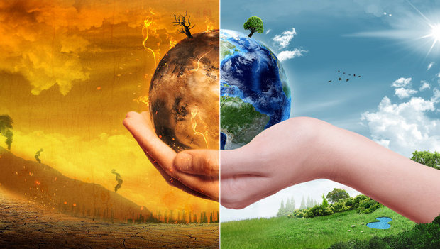
GREENING A BUSINESS
NIKITA ZALA

Slide 2
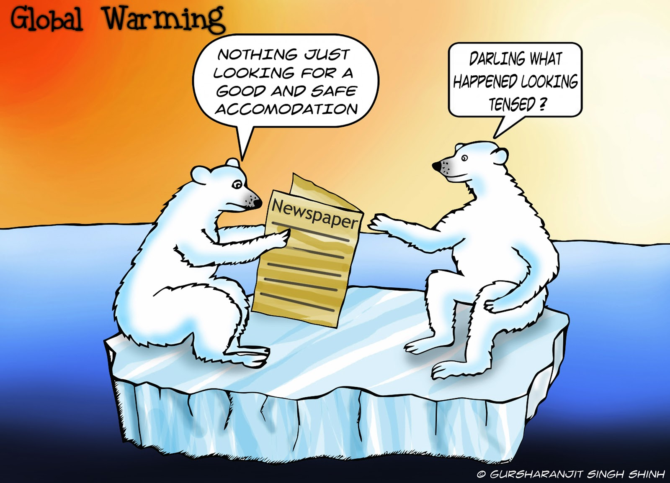
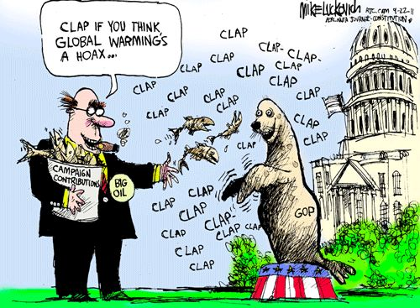

The great debate…
OR

Slide 3
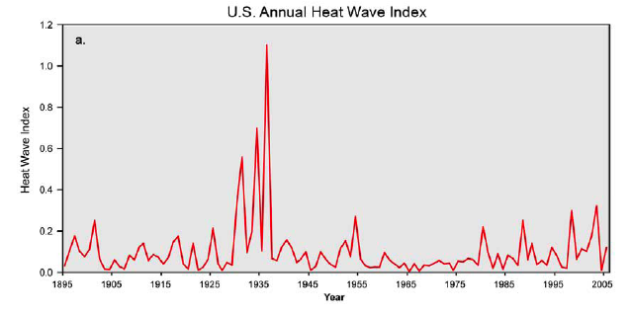
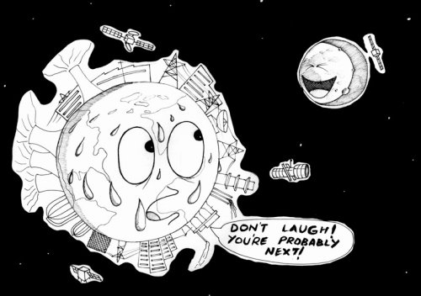
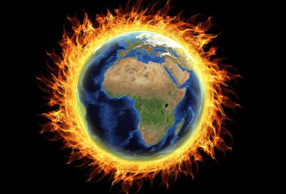
What is climate change ?
Climate is the aggregated pattern of weather, meaning averages, extremes, timing, and spatial distribution of…
Hot & cold
Cloudy & clear
Humid & dry
Drizzles & downpours
Snowfall, snowpack, & snowmelt
Blizzards, tornadoes, & typhoons.
Climate change = Altered patterns

Slide 4
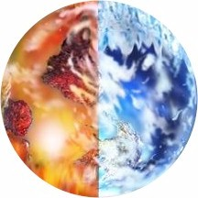
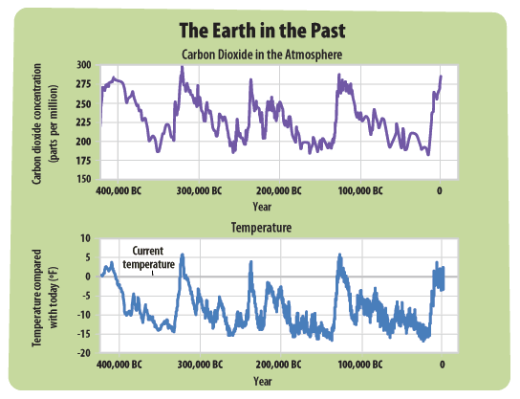
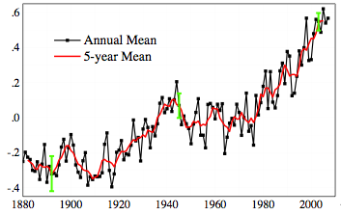
Earth’s Climate Is Not Constant
It has warmed….
....and cooled
For BILLIONS of years
These graphs are the proof of how Earth’s climate has fluctuated drastically over the years.

Slide 5
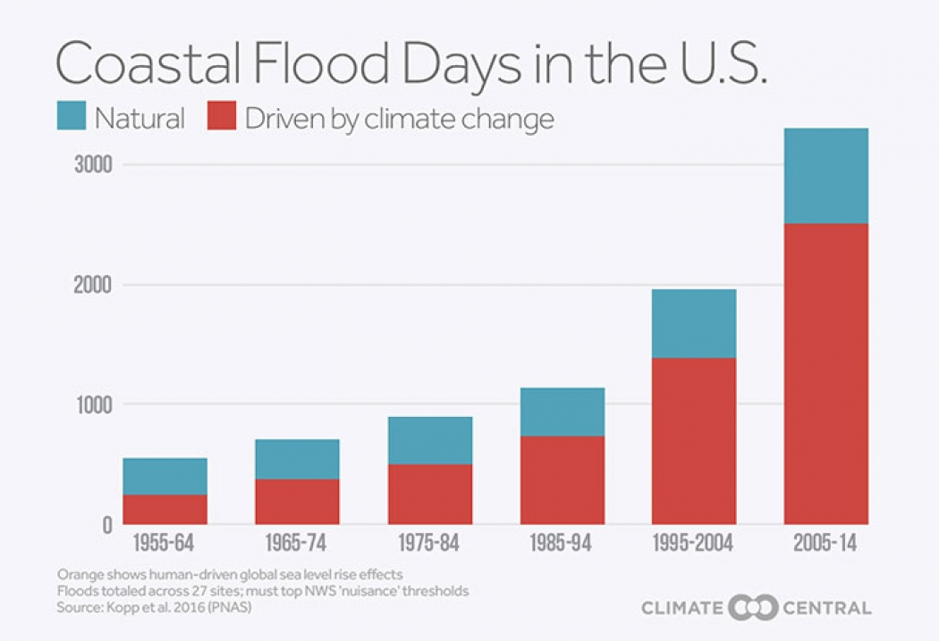
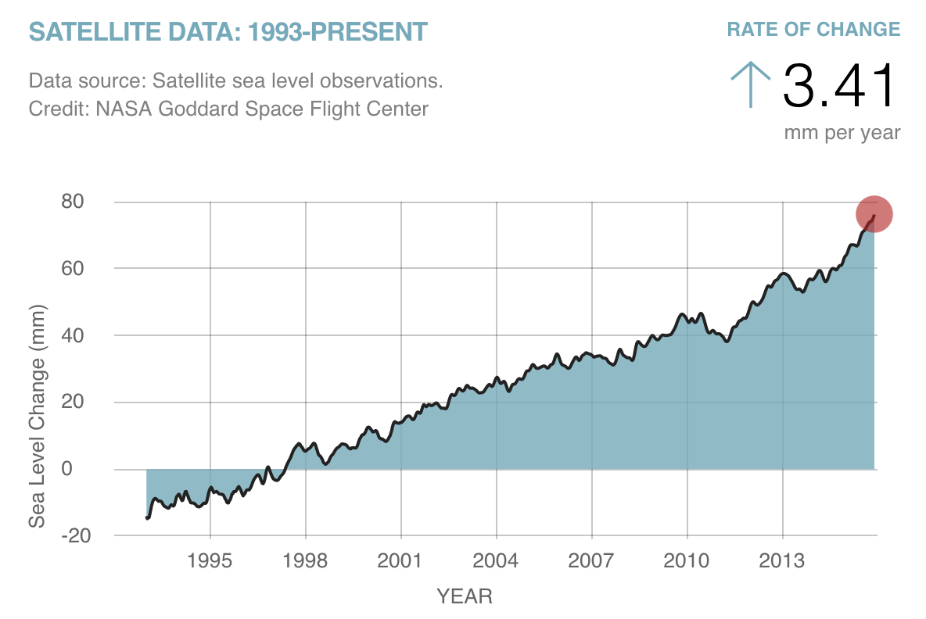
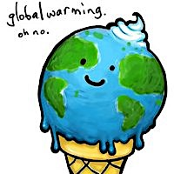
It’s happening…
Climate change is happening. It is not a hoax.
The real question: Is Global warming man-made or is it happening regardless??
DATA is the answer

Slide 6
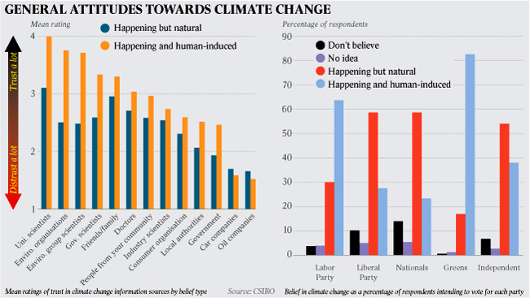
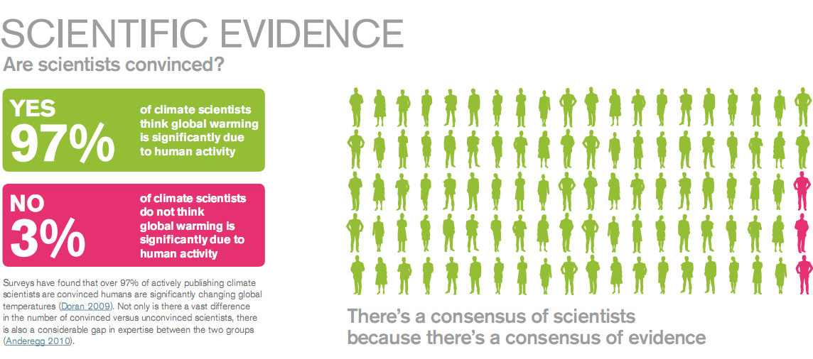
Take 1: Global Warming Is Man-made
This graph shows that except oil and car companies, most of the people including environmentalist believe that global warming is human-induced.
Two main reasons of global warming:
Increase production of green-house gas
Increase in atmospheric carbon dioxide.

Slide 7
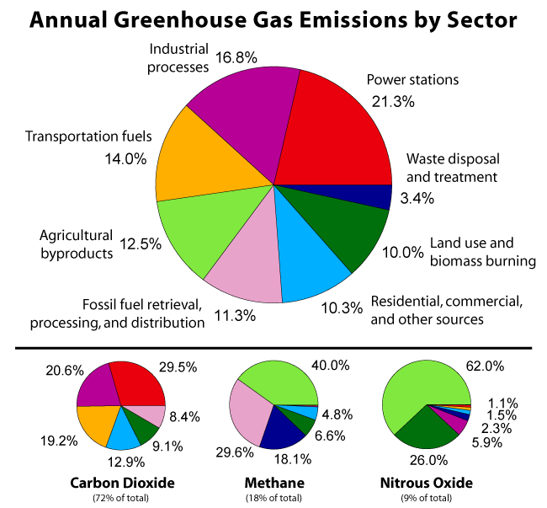
Green house gases:
Since the dawn of the Industrial Revolution, humans have increasingly been contributing unnatural sources of greenhouse gases into the system, causing the system unbalanced.

Slide 8
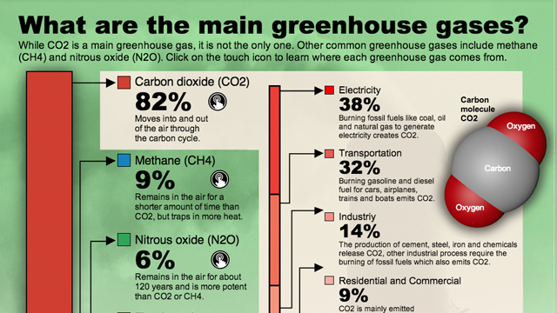
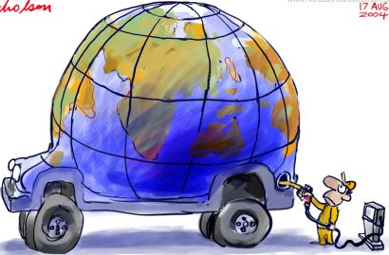
Green house gases cont.…
Humans are the real face behind increased production of green house gases.
We fuel up this process by polluting the atmosphere.

Slide 9
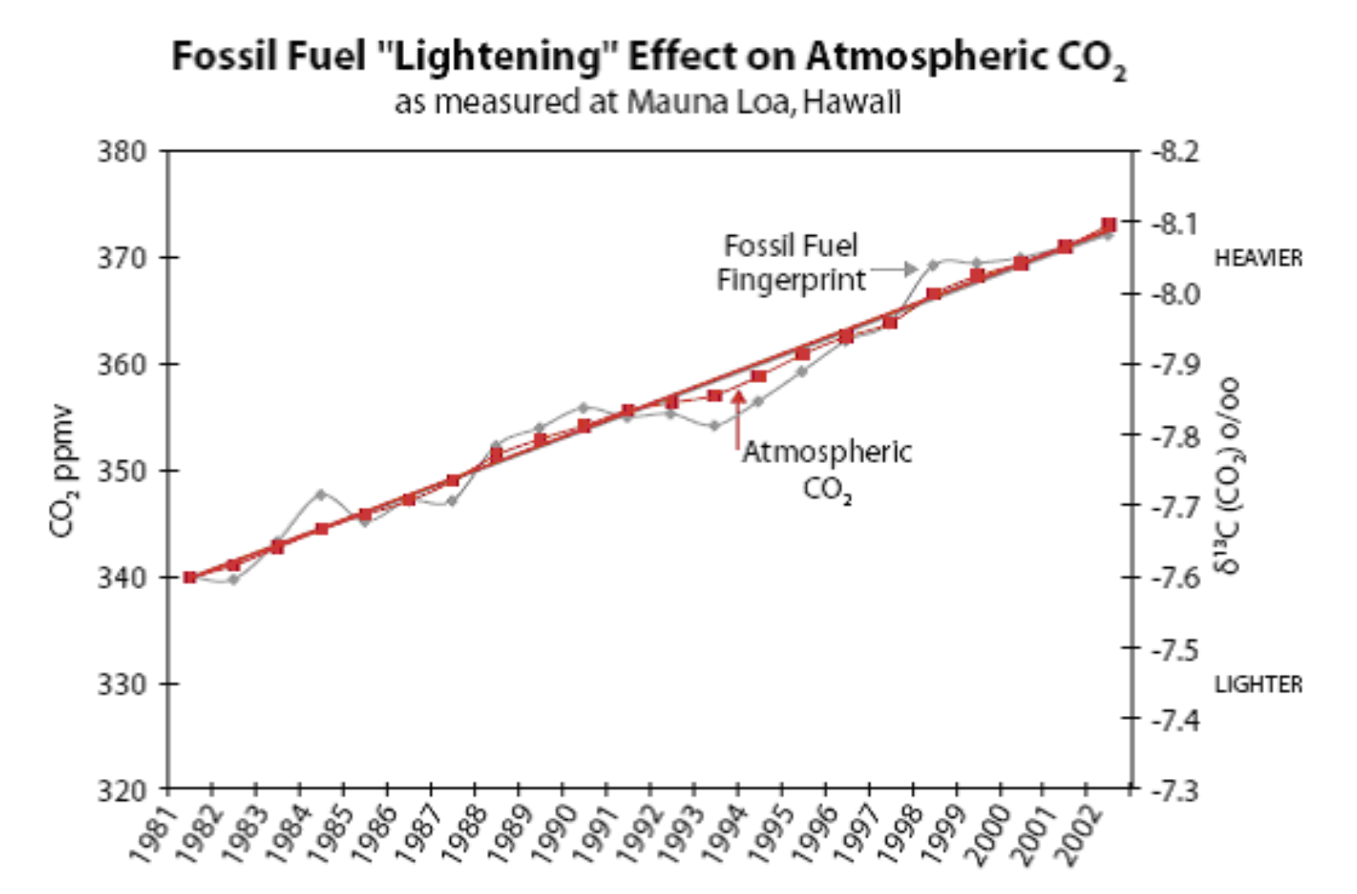
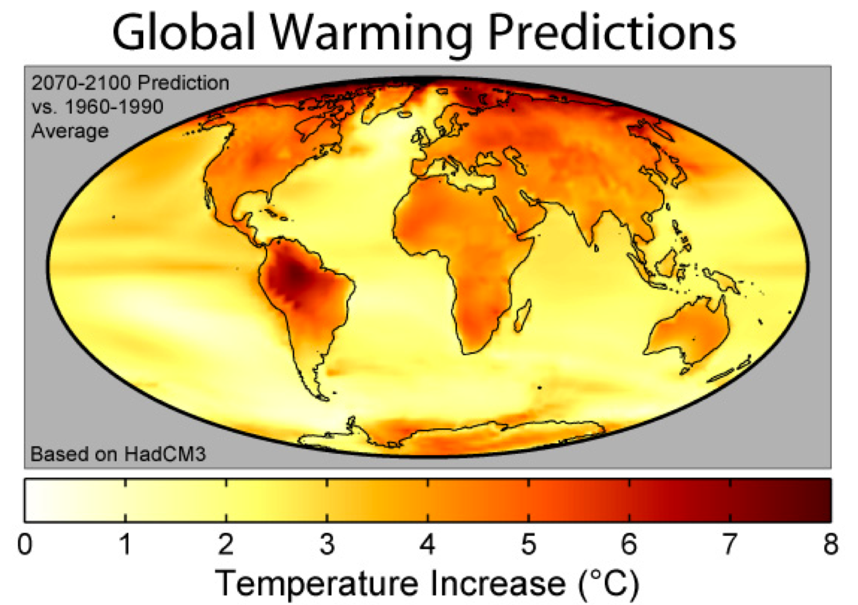
Increase in co₂
The extra CO2 gas comes from burning fossil fuel. This is a strong evidence to support the belief that humans play a significant role in increasing CO2 gas which further is a harm to the global climate, thereby, causing global warming.

Slide 10
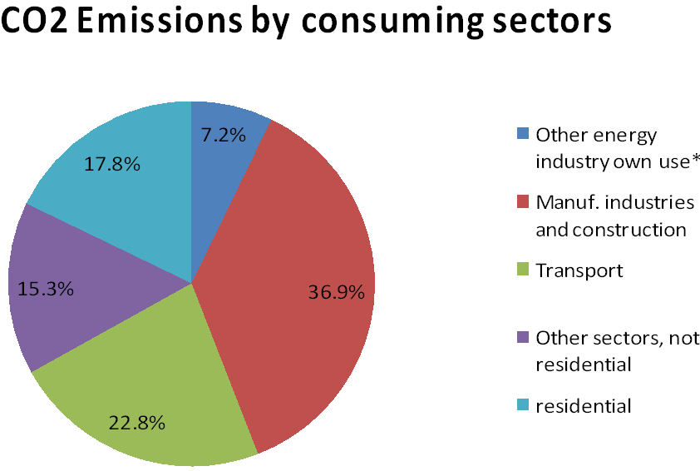
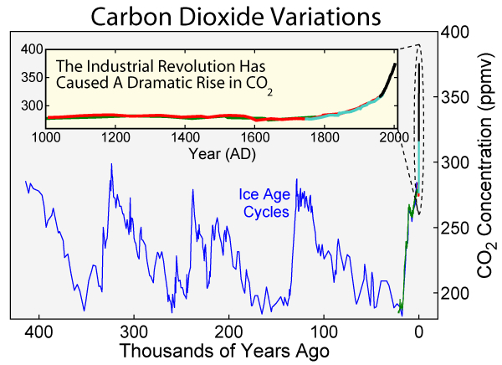
Increase in co₂ cont.…
The pie-chart is the CO₂ emissions by consuming sectors. It shows that manufacturing and construction industries are the top contributors in increase in atmospheric CO₂.
Humans are the real reason.

Slide 11
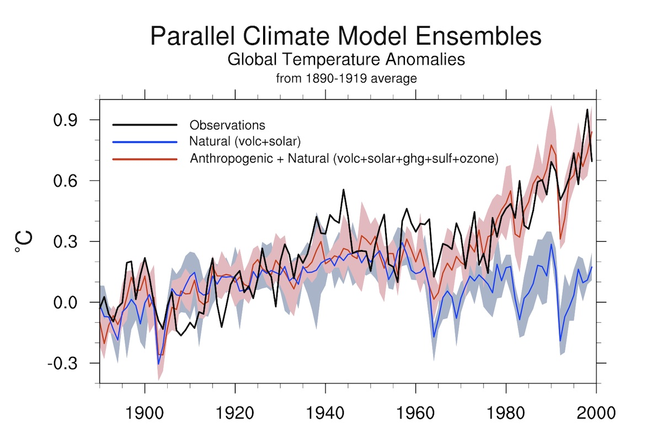
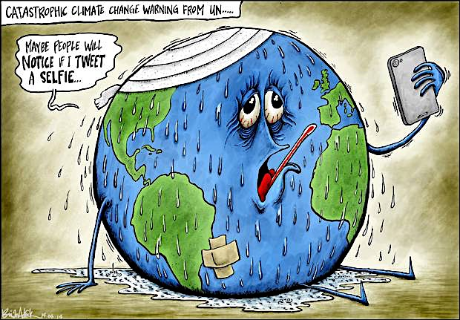
Take 2: global warming is natural
Very little research has ever been funded to search for natural mechanisms of warming. It has simply been assumed that global warming is manmade. This assumption is rather easy for scientists since we don’t have enough accurate global data to see whether there are natural warming mechanisms at work.
There are number of natural factors that play a significant role in global warming:
Volcanoes
The sun
Green house effect

Slide 12
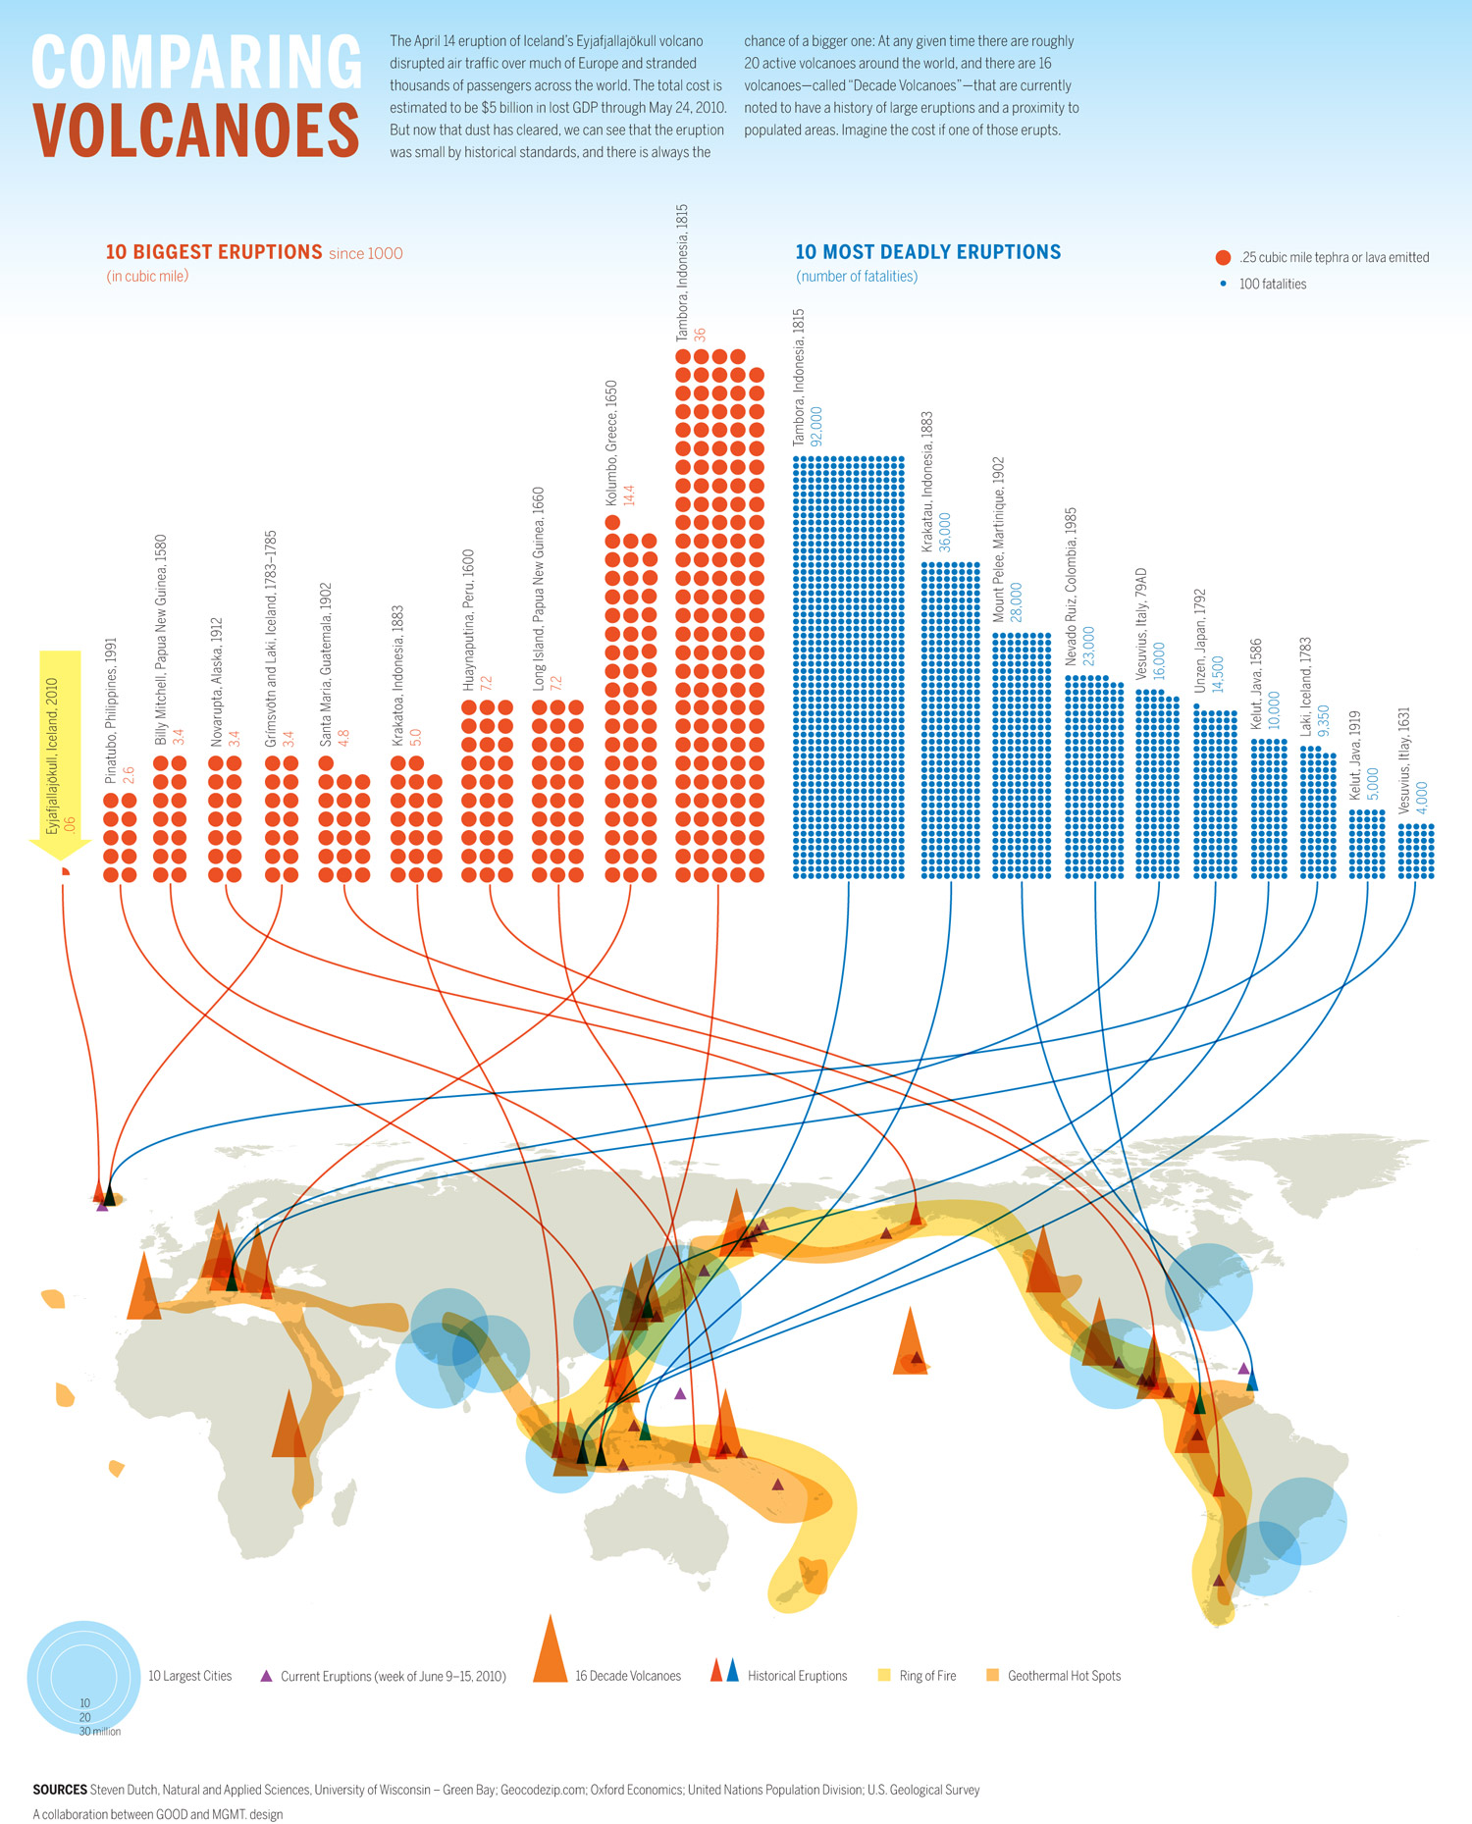
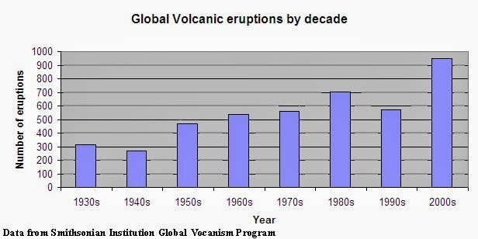
Volcanoes:
When a volcano erupts it throws out large amounts of Sulphur dioxide (SO2), water vapor, dust, and ash into the atmosphere.
Number of volcanic eruptions per year are gradually increasing.
This is one of the many natural factors causing a climate change globally.

Slide 13
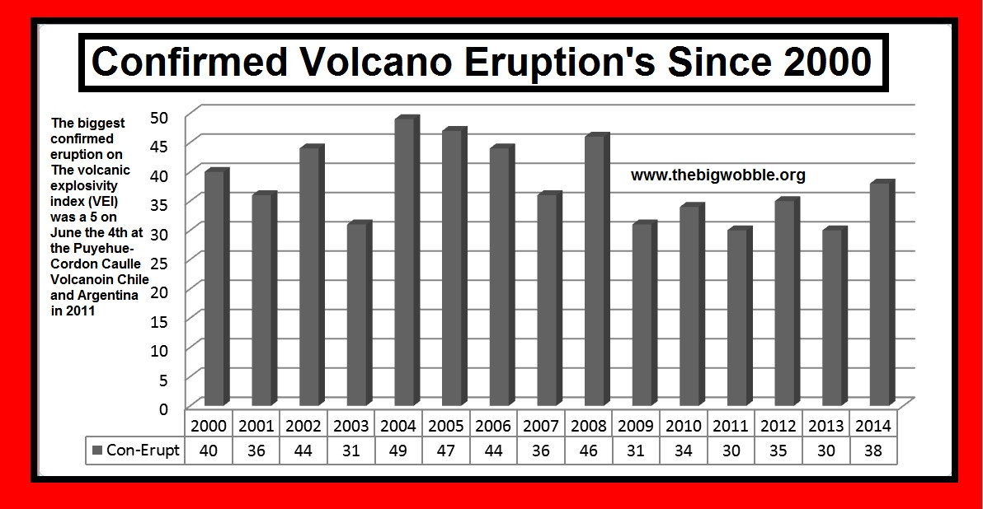

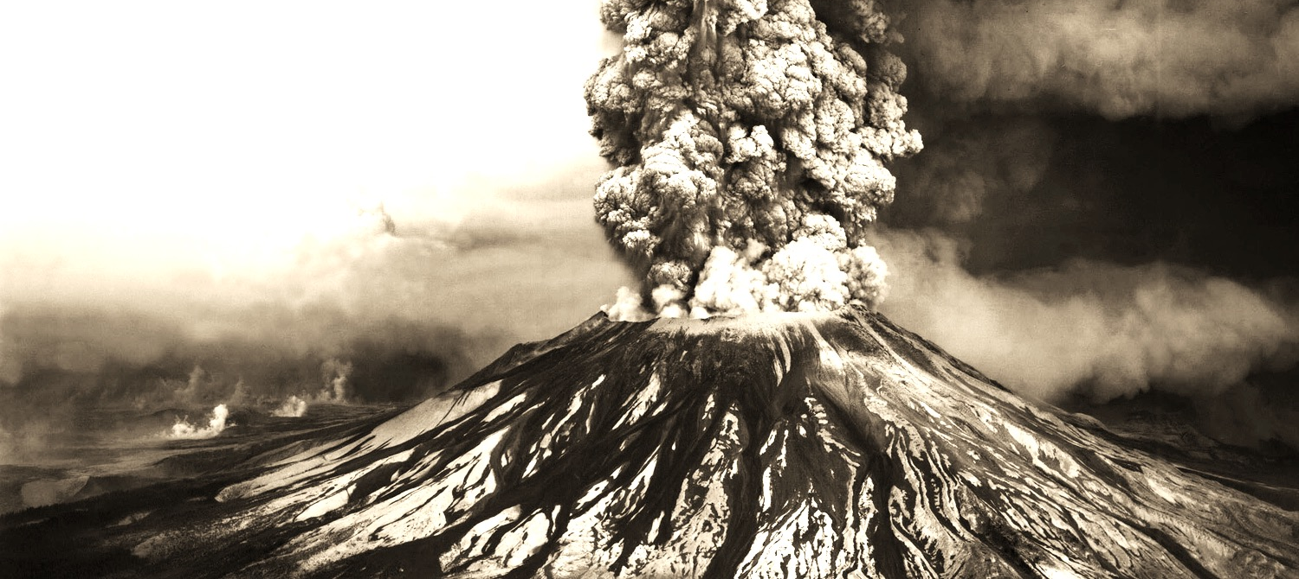
Volcanoes cont..
Even though volcanoes are in specific places on earth, their effects can be more widely distributed as gases, dust, and ash get into the atmosphere.
Because of atmospheric circulation patterns, eruptions in the tropics can have an effect on the climate in both hemispheres while eruptions at mid or high latitudes only have impact the hemisphere they are within.

Slide 14
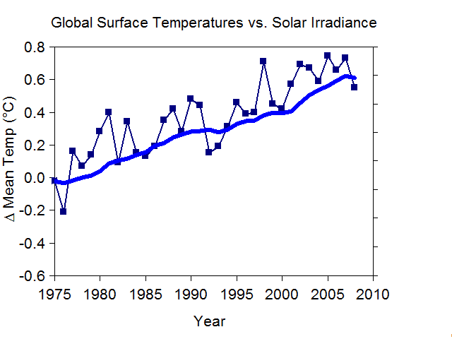
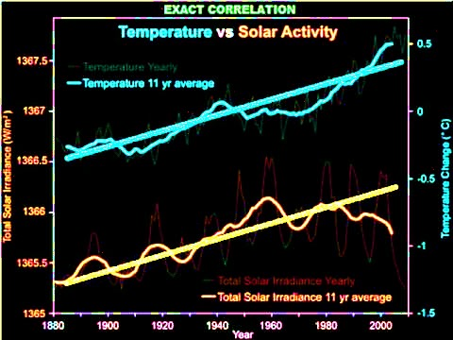
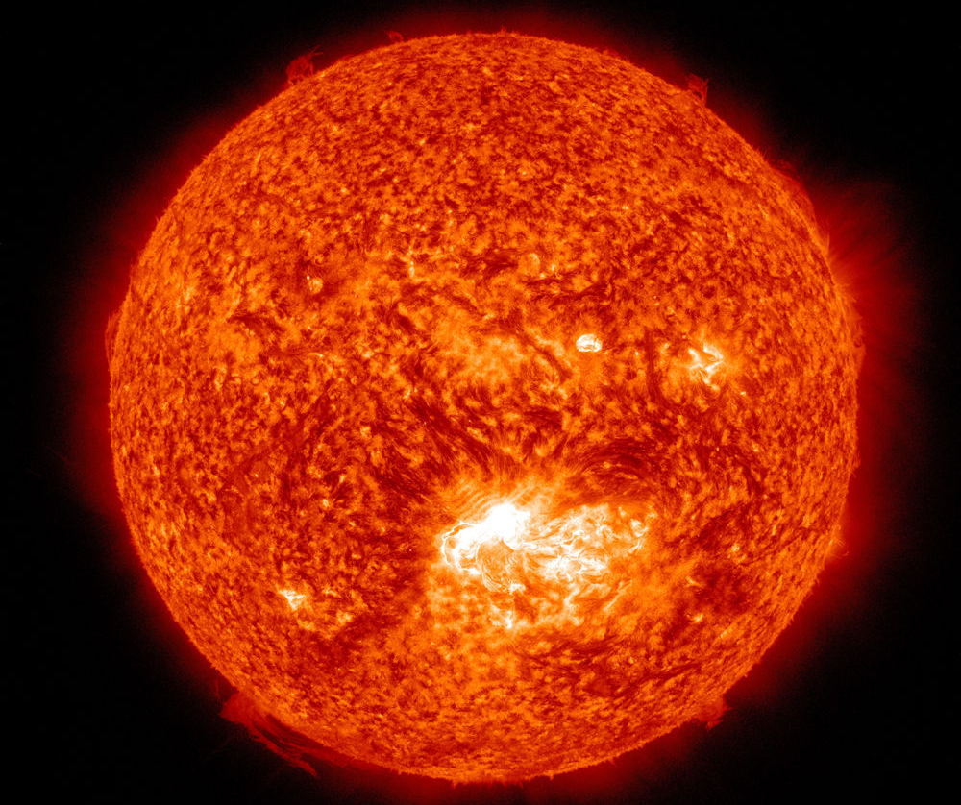
The sun
The amount of energy coming off the sun is not constant but keeps changing
Slow changes in the earth's distance from the sun affect the amount of energy received from the sun.
There is an exact correlation between solar activity and temperature.

Slide 15
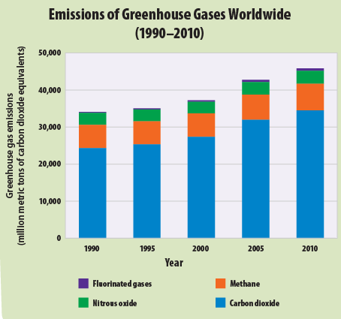

Green house effect
Greenhouse gasses (including CO₂) accumulate in the atmosphere. They absorb thermal radiation (heat) from the Earth’s surface, and redirect it back down to the Earth, heating up our planet. This is called the GREENHOUSE EFFECT.
Without the Greenhouse Effect, the Earth would be too cold for life….

Slide 16
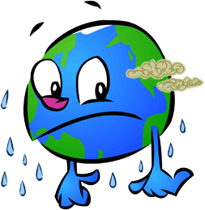
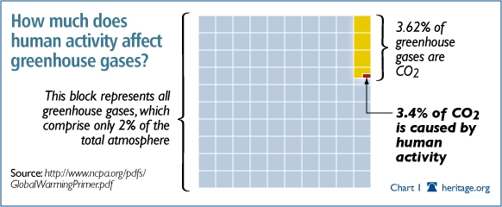
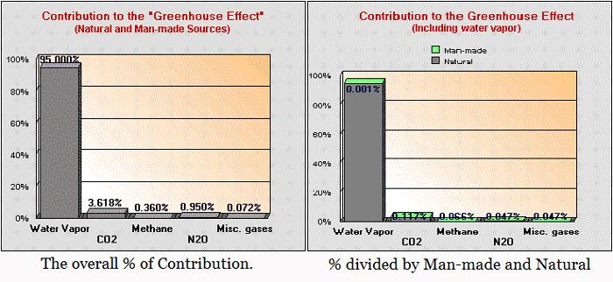
Green house effect cont.…
The graphs above shows how all the components of green house effect are a combined effect of natural process and climate change.
Humans play very little role in it’s change.
It’s all natural.

Slide 17
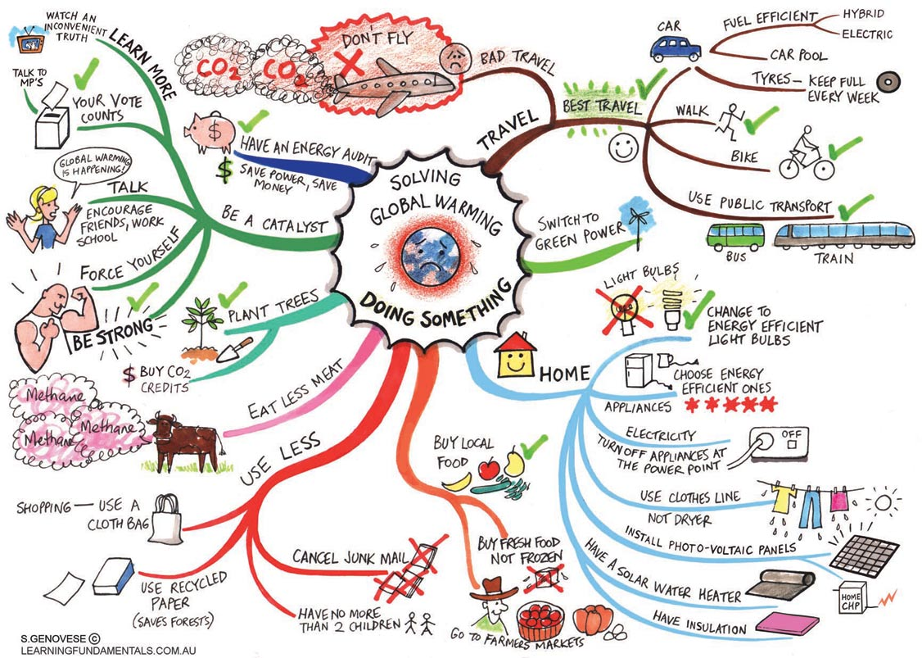
A NEUTRAL STAND-POINT
Global climate change is one of the most primary concern today. Not to forget, apart from its scientific and environmental reasons, it has become popular more because of its political takes.
It is difficult to come up with the the accurate percentage on natural and/or human induced data.
For example, we have the graphs for CO2 increase. But no graphs for how much of these CO2 is human induced and how much is natural induced.

Slide 18


conclusion
Even if there are multiple natural factors affecting global climate, it is always good to have humans not involved in being the cause.
This might not stop the climate change, but will definitely ease from the rapidness of the change.
In the spirit of the “Earth day” coming up,

