Slide 1
Academic Culture of
Athletic Programs
By: Alex Gong

Slide 2
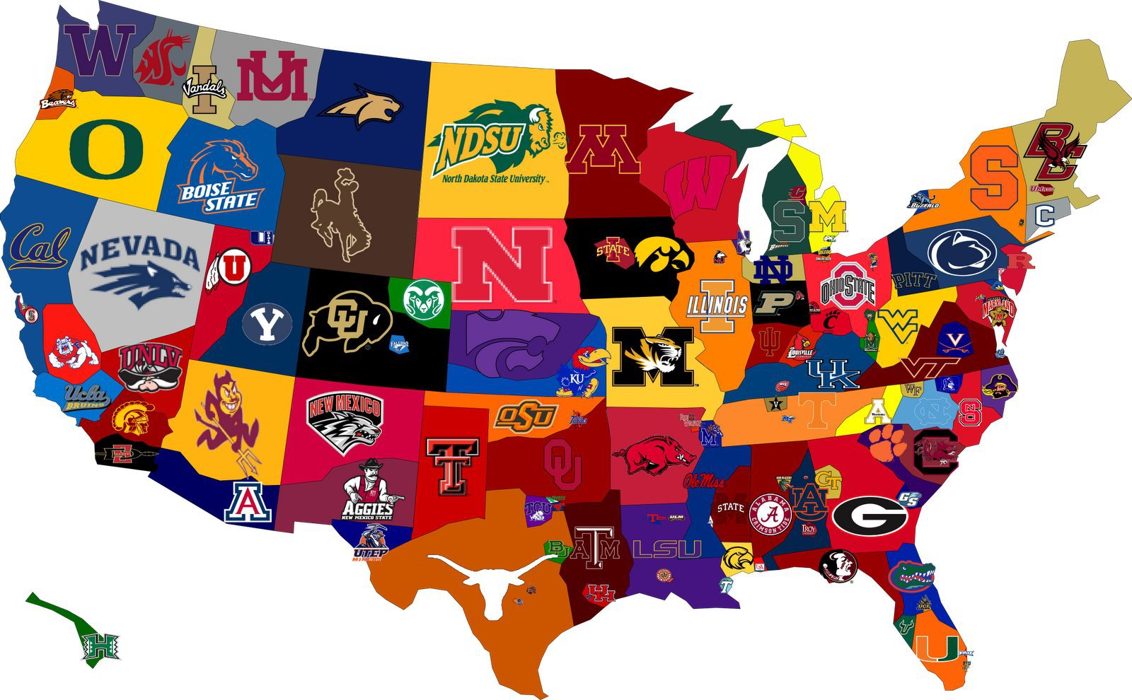
Data
Data was collected on the academic success of athletes from different colleges
Data was collected from Division I, II, and III athletes
Scores determined over a 4 year period and determined by factors such as athlete eligibility and retention
Scale of 1000

Slide 3
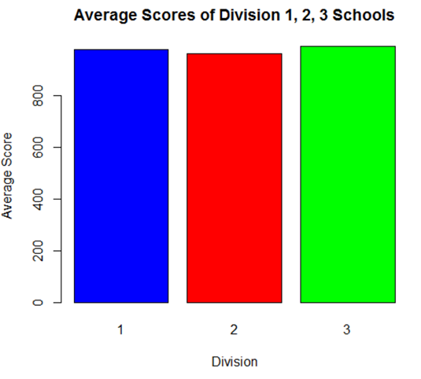

Divisions Academic Standing
It is well known Division I Schools typically out perform Division II and III schools athletically, but which Division is more successful academically?
Data shows that Division 3 Athletes perform the best academically while Division 2 Athletes perform the worst, but are Division 3 athletes that much better?

Slide 4

Division II vs. Division III Academics
Use a Z-test to determine if there is a significant difference between the 4 year academic scores between Division II and Division III athletes
Zeta = 12.6378
p = 0
Since p < 0.05, Division III athletes have a significantly higher 4 year academic score than Division II athletes

Slide 5
Division I vs. Division III
Use a Z-test to determine if there is a significant difference between the 4 year academic scores between Division I and Division III athletes
Zeta = -6.327824
p = 1.24 x 10^-10
Since p < 0.05, Division III athletes have a significantly higher 4 year academic score than Division I athletes

Slide 6

What about Rutgers?
It has been determined that Division III athletes outperform Division I athletes, but how do Rutgers athletes compare to other schools
Rutgers is known to be a research university, but are our athletes smart?
Which athletic programs at Rutgers perform the best academically?
How does Rutgers compare to other Big Ten Schools?

Slide 7
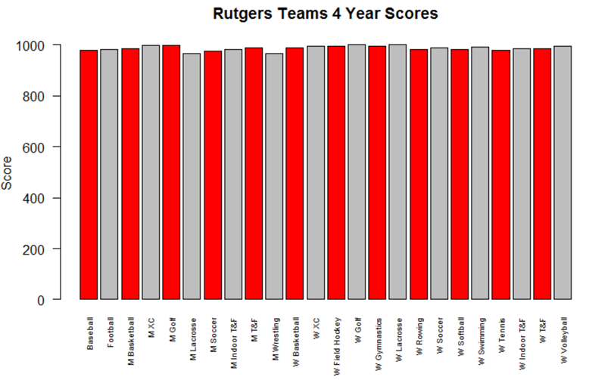
Rutgers Teams
The average 4 Year Academic score for Rutgers University Athletic Teams is 986.125
The Teams with the Highest scores are Women’s Lacrosse and Women's Golf
The highest score possible is 1000
Not Bad Rutgers!

Slide 8
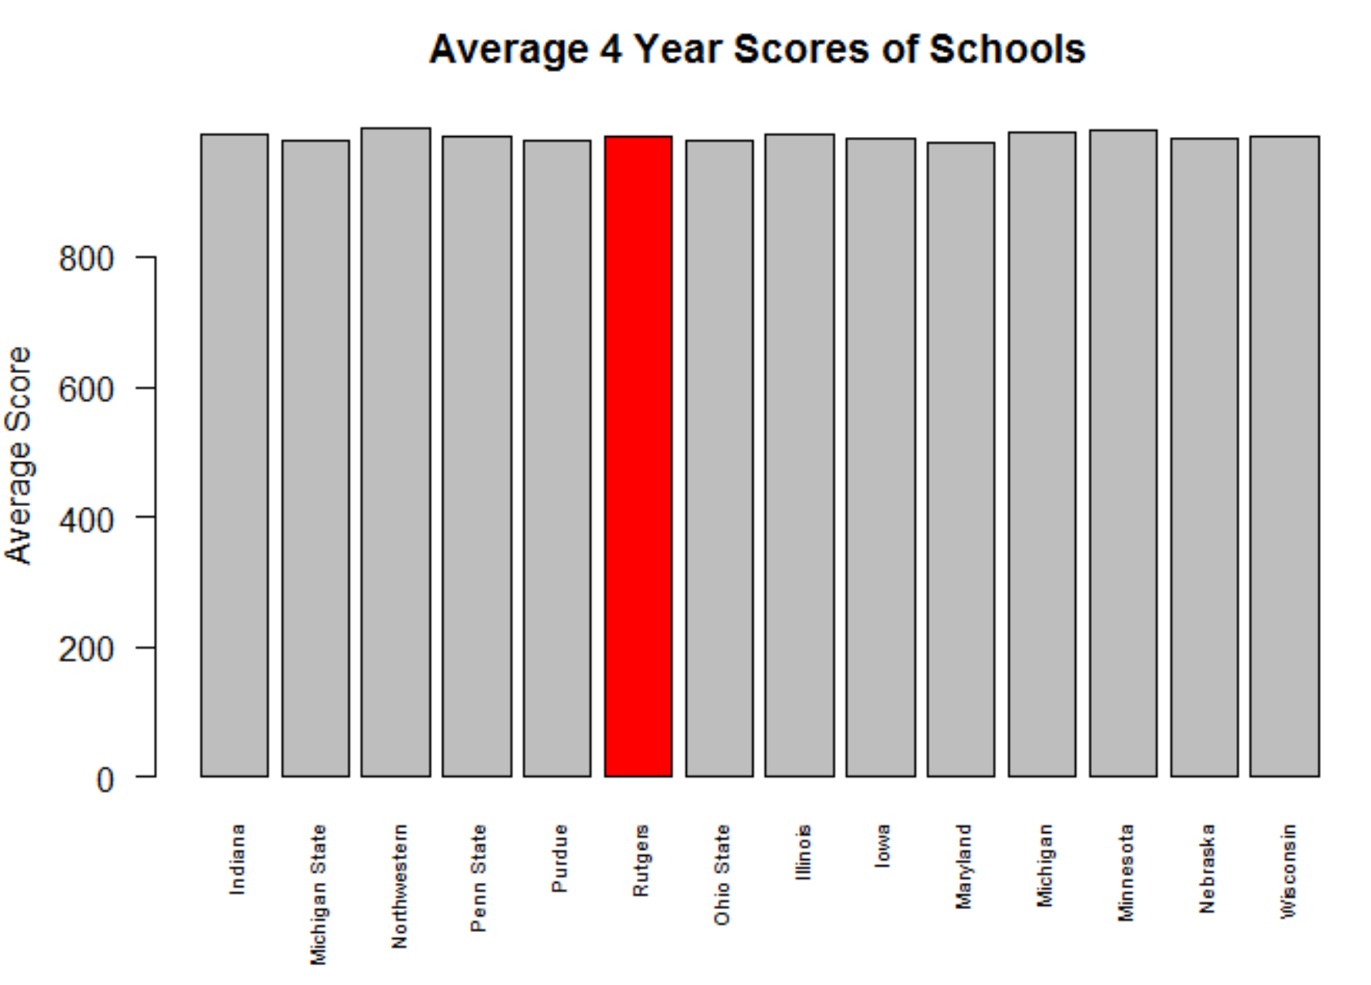
Rutgers vs. The Big Ten
The 4 Year Average of the Big 10 schools is 984.9384
Rutgers Average is 986.125
Rutgers Athletic Programs are above the Average!!!

Slide 9

In conclusion
Division III school athletes perform better academically than Division I and II school athletes
Perhaps this can be attributed to benefits of Division III schools such as smaller class sizes and less traveling for games
Looking at Rutgers teams, the athletes with the most academic success are Women’s Golf and Lacrosse players
In addition, Rutgers athletes perform slightly better than the average Big Ten Athlete

